Slide 1
WICCI CHANDIGARH PSYCHOLOGICAL WELLBEING COUNCIL
WOMEN´S INDIAN CHAMBER OF COMMERCE AND INDUSTRY
www.wicci.in

Slide 2
Council Vision &Mission
Vision
We envision a city where any citizen, regardless of age, gender, or identity, can achieve holistic well-being with the help of knowledge on how to unlock their true potential along with support systems that ensure their physical and psychological safety.
Mission
To create a space for women folk who are passionate about mental health to learn, grow, and empower each other so that we can collectively achieve well-being and help fellow citizens of Chandigarh to do the same.

Slide 3
Welcoming
Council Members to
WICCI
President, Vice President
and 20+ Nominated Council Members

Slide 4
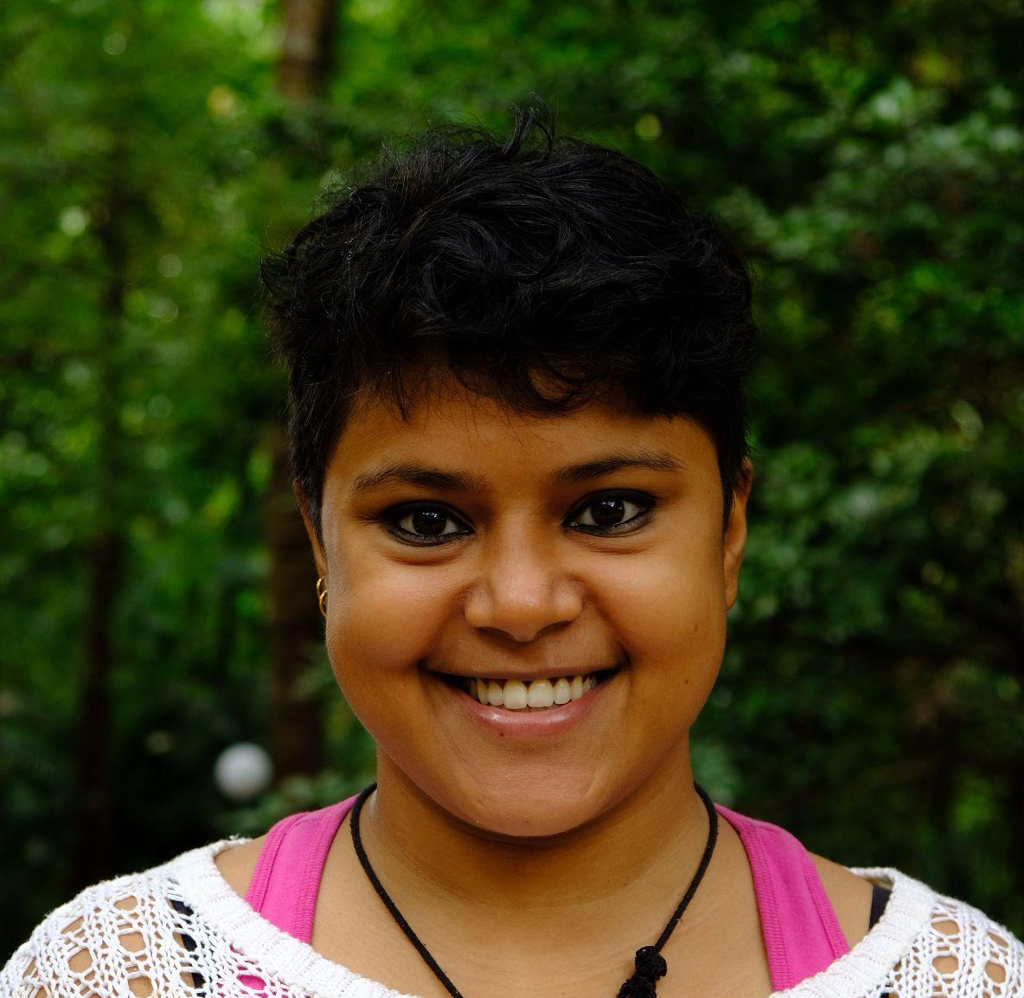
ADRIJA CHAKRABARTI
STATE PRESIDENT, CHANDIGARH PSYCHOLOGICAL WELLBEING COUNCIL WICCI
Adrija Chakrabarti is a trauma-informed therapist and the founder of The Mental Health Movement Chandigarh (MHM), an organisation providing affordable mental health services and learning opportunities.
She started her career as an independent psychologist in 2019 specialising in trauma and recovery. Her work involves helping clients recover from sexual violence, domestic violence, and abuse. Through MHM, Adrija attempts to share this knowledge and training with fellow mental health professionals and social workers.
Adrija is also a mental health consultant. She has helped facilitate several training programmes and workshops related to mental health with NGOs such as Nirantar and Sahjani Shiksha Kendra. In 2022, she was invited as a co-creator to participate in the Feminist Leadership Lab organised by UN Women India.

Slide 5
TUNGKOIBEE YUMNAM
STATE VICE PRESIDENT, CHANDIGARH PSYCHOLOGICAL WELLBEING COUNCIL WICCI
Tungkoibee Yumnam is a first year postgraduate psychology student who is known for her work in promoting the visibility of LBQ women in northeast India and has been the face of a campaign called “Yes We Exist” in 2019 that focuses on the acceptance of queer women in the region.
She has gained valuable experience in the field of psychology through her volunteering work at Psy-Fi Mental Health, where she learned from industry experts about how various elements of media, mental health, psychology, law content, etc. interact with each other. She has also worked as a tutor at Psych-a-way Analysts, where she taught 13 psychology students of grade 12th and covered in-depth syllabus, additionally, ran mentor sessions to assist students with problems and doubts.
Overall, Tungkoibee is an individual who is dedicated and compassionate towards promoting social justice and equality. And as a psychology student, she has always been passionate about helping others.

Slide 6
DRISHTI OHRI
COUNCIL MEMBER, CHANDIGARH PSYCHOLOGICAL WELLBEING COUNCIL WICCI
Drishti Ohri is a mental health advocate and a psychology graduate from Chandigarh, India. Her dream for a very long time has been to contribute to mental healthcare. She is currently studying for a Postgraduate Diploma in Child Guidance and Family Counselling at Dev Samaj College of Education, Chandigarh.
She is also actively working towards a Master’s degree. She spends her time volunteering with organizations that are passionate about the same causes as her. She has interned in a diverse set of fields, including career counselling, special education, and research.
She has previously been associated with organizations such as Youth for Mental Health, Sukoon, and World Federation for Mental Health. Literature and social media content interest her. She spends her leisure time curating content for her blog.

Slide 7
NAVJYOT KAUR DHILLON
COUNCIL MEMBER, CHANDIGARH PSYCHOLOGICAL WELLBEING COUNCIL WICCI
Navjyot Dhillon is a counselling psychologist with 15+ years of working in various settings ranging from clinical, educational, corporate and telepsychology. Exposure to each of these fields has given her a unique perspective and deep understanding of how mental health plays a defining role in the lives of students, professionals as well as those suffering from clinical conditions.
She believes being a mental health professional there could be no better time than now to reach out and support people out there. She works with the conviction that all humans have the innate potential to work on themselves when provided the effective underpinnings of unconditional positive regard , psychoeducation ,therapeutic interventions and referrals.
There’s no time to waste when we have to ease the lives of millions.

Slide 8
AASTHA GANDOTRA
COUNCIL MEMBER, CHANDIGARH PSYCHOLOGICAL WELLBEING COUNCIL WICCI
Aastha Gandotra is a Counselling Psychologist and has her private practice -Mind Oasis by Aastha. She works with a belief that every individual is unique and so are their lived experiences hence, in the collaborative space created by her and her clients, she helps them reflect on their journey and their challenges along with instilling a sense of self-compassion and self-acceptance in themselves.
She works towards the holistic development of her clients which includes working on both mental and physical health. She is a trauma-aware, queer-friendly and EFT trained therapist who primarily works with a client-centered/person-centered approach along with incorporating somatic work and techniques from various other therapeutic modalities.
Her aim as a psychologist is to destigmatize mental health and make people understand that overall well-being doesn’t just include good physical health but also mental health.

Slide 9
AMBIKA AGNIHOTRI
COUNCIL MEMBER, CHANDIGARH PSYCHOLOGICAL WELLBEING COUNCIL WICCI
Ambika Agnihotri is a Counseling Psychologist and a Wellbeing coach. She is passionate about helping individuals tap their highest potential, embark on their self-growth journey and be happier and healthier. She has worked in the field of mental health in different capacities and roles over the years. Her experience ranges from being in the social, medical, rehabilitation and corporate settings.
Ambika is fascinated by the human body mind and system, and believes that every single person can benefit from working on their health and wellbeing. She finds nothing more rewarding than having a positive impact on the people and clients she interacts with everyday. She is passionate about holistic health and works with a diverse set of modalities such as cognitive and sub-cognitive therapies, energy techniques and mind-body practices among others.

Slide 10
PULKITA WADHWA
COUNCIL MEMBER, CHANDIGARH PSYCHOLOGICAL WELLBEING COUNCIL WICCI
Pulkita Wadhwa is a Counseling Psychologist who is currently associated with Jumping Minds and Hemkunt Foundation.
She has a master's degree in psychology, a NIMHANS diploma in Community psychology and Diploma in Family Counseling from Panjab University. She is an active enthusiast and lifelong learner who tries to give her best in every situation.
She attempts to assist others in making changes in their lives through her experience, knowledge, and understanding as she is a firm believer that there is always a solution to a problem. In addition to the degree and skill set of a Psychologist, she is also a Professional Theatre Artist.
Her involvement in theatre has improved her comprehension of various ideologies, her theatre work is oriented towards psychological dramas, she believes in spreading awareness through art.

Slide 11
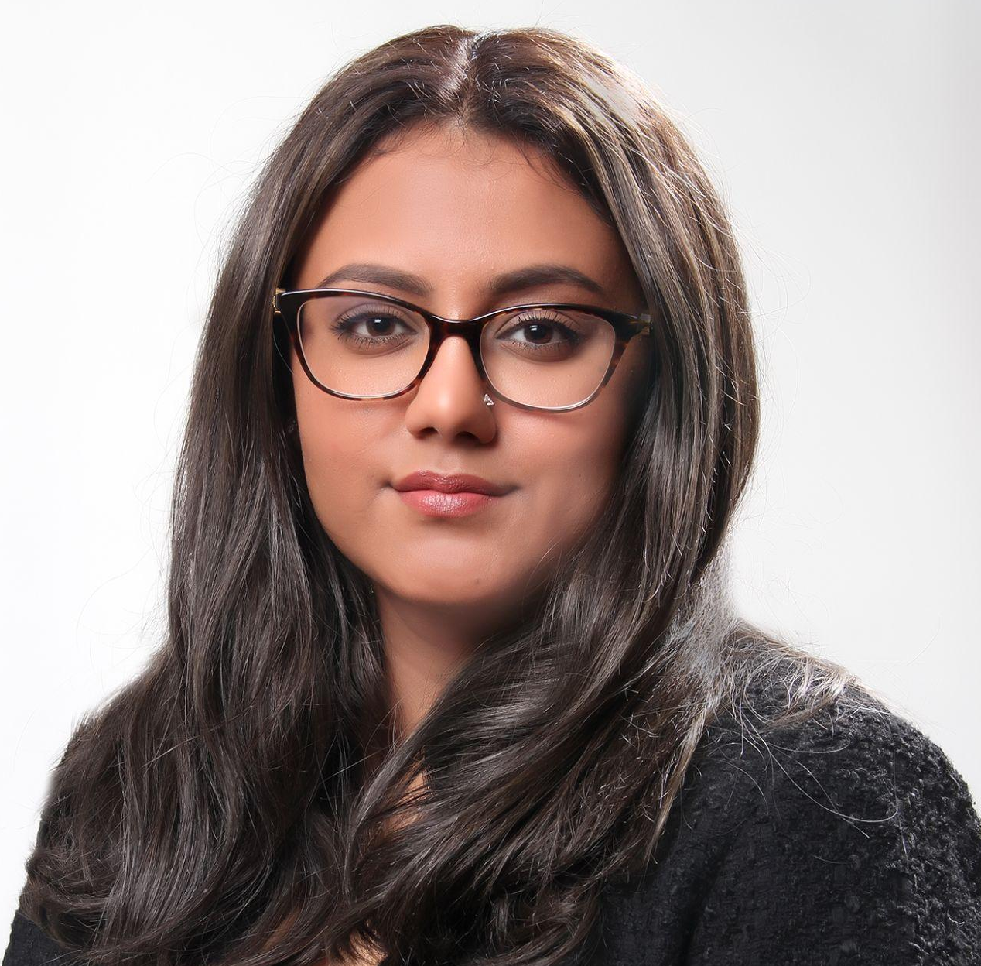
RAVNEET KAHLON
COUNCIL MEMBER, CHANDIGARH PSYCHOLOGICAL WELLBEING COUNCIL WICCI
Ravneet kahlon, a counselling psychologist who runs her very own “Wellness by Ravneet” Clinic wherein, just in the span of 2 years of time, she has taken more than 2000+ appointments.
She has studied Psychology first and later studied Neuroscience from Kings college London to expand her knowledge around the field of Mental health for better understanding of human behavioural patterns.
She works with a holistic approach to her practice but is known for her focus on self mastery through awareness as an approach for getting out of mental health crises.
She is currently working on publishing majority of her case studies to help fellow psychologists for her approach used towards helping her clients.

Slide 12
PRERNA JOSHI
COUNCIL MEMBER, CHANDIGARH PSYCHOLOGICAL WELLBEING COUNCIL WICCI
Prerna is a bold, ambitious and emphatic proponent of mental health who is exploring and embracing herself with every passing day .
She works as an Administrative Officer in a PSU , where she's gained a lot of experience and understanding of how the rural India and the govt sector works.
She is a strong advocate of therapy and has worked actively to start the conversations of mental health and therapy in her not liberal circle . After working with a few therapists to work on herself, she has a deeper understanding of how important mental health is.
Her greatest achievement the past year has been encouraging 8 people towards starting therapy (Who are very happy with the results) and to have become the go to person in her extended friend circle when it comes to finding thE right kind of therapist. She is looking forward to creating a more socially accepting perspective towards mental health and hopes for a world where therapy is accessible to everyone in need.

Slide 13
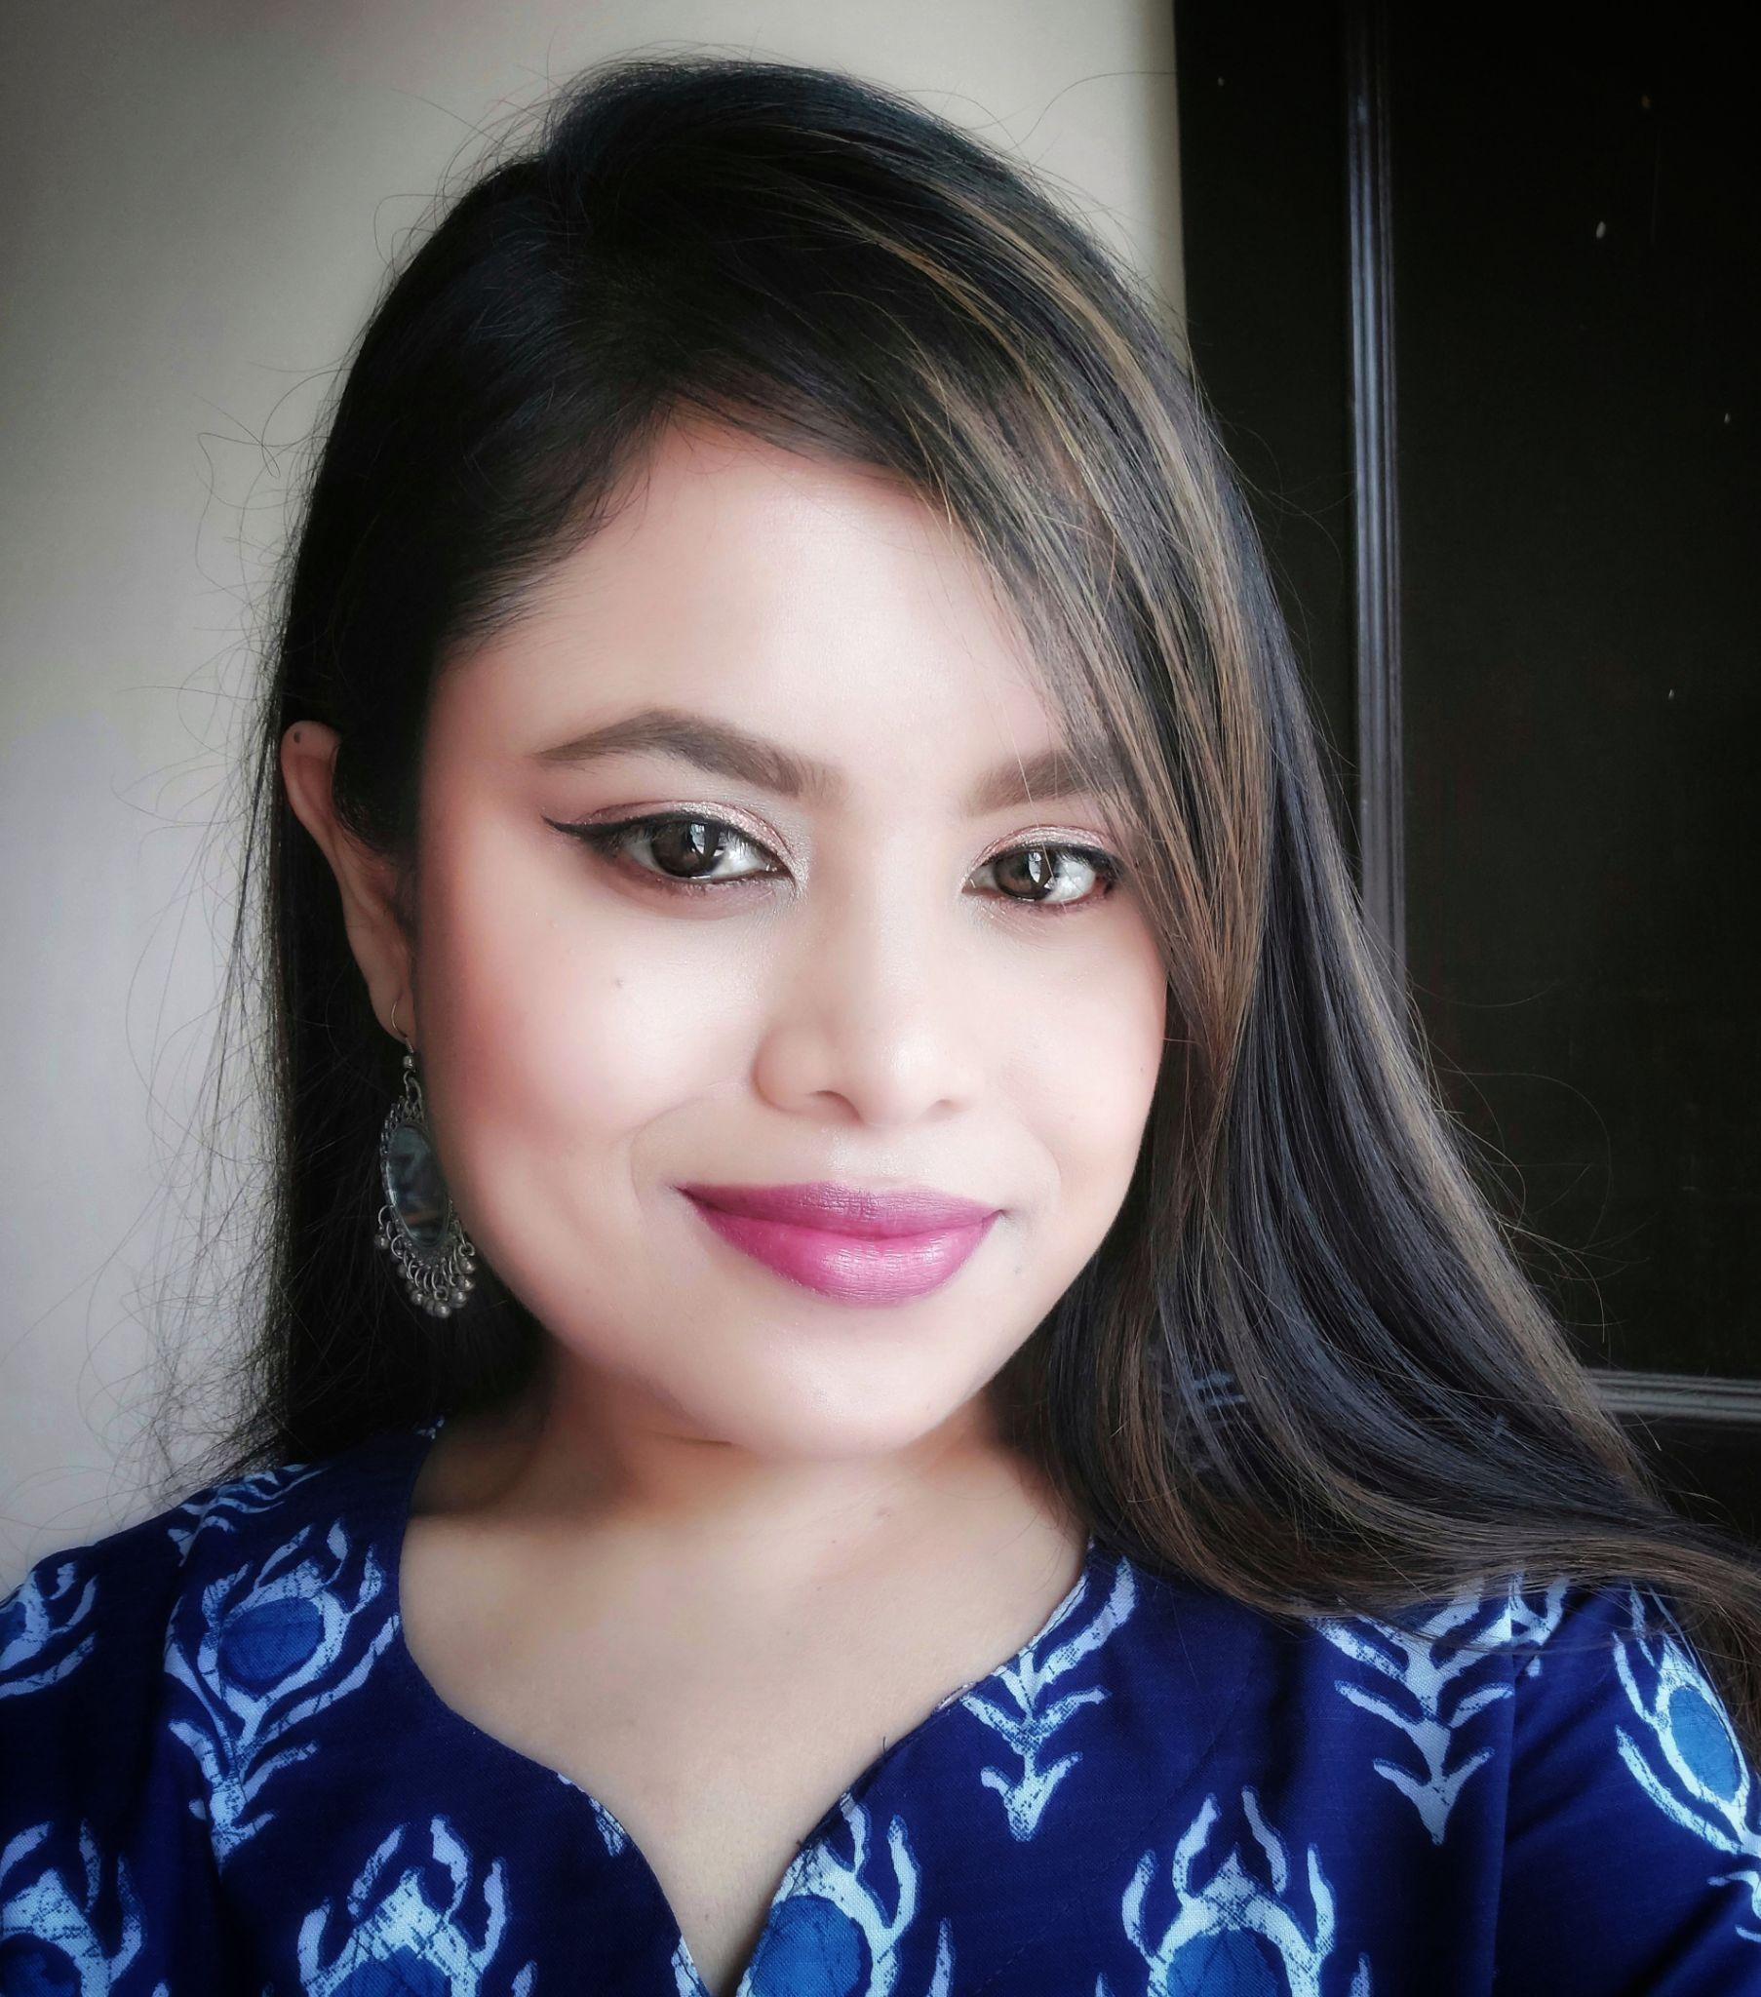
PALLAVI ROY
COUNCIL MEMBER, CHANDIGARH PSYCHOLOGICAL WELLBEING COUNCIL WICCI
Pallavi is an inclusive counselling psychologist &amp; psychotherapist with 4 years of experience (over 1500 hours of providing therapy sessions). She employs an integrative therapeutic approach that is derived from humanistic, third wave therapies and mindfulness-based practices. Her therapy offerings are trauma informed, queer affirmative and rooted in intersectionality.
Pallavi has experience working with anxiety, depression, relationship concerns, personality difficulties, self-esteem issues &amp; personal development, dementia and caregiver stress. She primarily works with adults and older adults (aged 18 to 90+).
Pallavi has been a part of several organizations in the role of a counselling psychologist. She is also practicing privately (@therapywithpallavi) working with clients based out of India and abroad.

Slide 14
GEETIKA SHARMA
COUNCIL MEMBER, CHANDIGARH PSYCHOLOGICAL WELLBEING COUNCIL WICCI
Ms. Geetika Sharma has been practicing as a Psychologist for more than a year. She is an MA in Psychology and diploma holder in psychotherapy. She started gaining experience professionally by providing sessions to Autistic children’s parents. Currently, Geetika is working with a hospital as a psychologist and psychotherapist. Healing clients from depression, stress, anxiety, and relationship issues, and improving their self-esteem.
Geetika also has experience working as a career counselor for an organization, where she guided students on how to improve both their professional careers as well as their overall personalities. She has led numerous seminars for raising awareness of career selection at various schools in various cities.
Her goal is to raise awareness of the importance of mental health and encourage people to live happier, healthier lives.

Slide 15
MANVINDER GILL
COUNCIL MEMBER, CHANDIGARH PSYCHOLOGICAL WELLBEING COUNCIL WICCI
Manvinder Kaur Gill is a researcher and social worker whose work is centred on culture, colonialism, and health. She holds a BSc. and a BA (hons.) from the University of Winnipeg, an MA in religious studies from McMaster University, and most recently finished her Master of Social Work at the University of Toronto.
Her research specifically focuses on immigrant mental health and substance use in Panjabi and Sikh communities. She currently works in Punjab, India as a research associate for MIT’s Abdul Latif Jameel Poverty Action Lab (J-PAL) on a project centered on improving opioid addiction prevention protocols in high schools in collaboration with the Government of Punjab’s Department of
Education and researchers from UC Berkeley.

Slide 16
ANMOL SINGH
COUNCIL MEMBER, CHANDIGARH PSYCHOLOGICAL WELLBEING COUNCIL WICCI
Anmol is a compassionate counselling psychologist who currently serves as a student counsellor at Chitkara University. With some years of experience in the field, Anmol has developed an innate understanding of the struggles and challenges that students face in their academic and personal lives.
She believes everybody is a work in progress and can change for the better, each step of the way, if willing. She offers a non-judgmental, caring, and understanding safe space and believes in empowering each individual who doesn’t feel like their best self on bad days.
Anmol is committed to enhancing the overall well-being of individuals and creating a positive impact on their lives. Whether it is dealing with stress, anxiety, relationship issues, or any other concern, Anmol is always there to support and guide them towards a brighter future.

Slide 17
SANA SOOD
COUNCIL MEMBER, CHANDIGARH PSYCHOLOGICAL WELLBEING COUNCIL WICCI
Ms. Sana Sood is a counselling psychologist and a certified career coach. She has completed her Masters from Panjab University and qualified GATE 2023.
She is currently pursuing an RCI licensed diploma in Child guidance and counselling after which she plans to work towards the wellbeing of people by breaking the stigma around mental health and empowering the weaker sections of the society.
She has interned in various clinical and HR settings and has also worked in a reputed school for a few months.
She is really passionate about her field and wants to bring a significant change.

Slide 18
ADITI MITTAL
COUNCIL MEMBER, CHANDIGARH PSYCHOLOGICAL WELLBEING COUNCIL WICCI
Aditi Mittal is an art director. She is a founder of multi-disciplinary design studio, Maditiss.
She has a Master's degree in Psychology from MCM DAV college for Women, chandigarh.
With imagination, collaboration, attention to detail and skill at her core, she designs solution and products with personality, depth of thought and visual appeal.
She believes that a user centered approach in design system ensures that projects are tailored to the needs of the community.

Slide 19
AAMEEKUL SINGH
COUNCIL MEMBER, CHANDIGARH PSYCHOLOGICAL WELLBEING COUNCIL WICCI
Aameekul Singh is a Counselling and Organisational Psychologist based in Chandigarh, India. She completed her Masters of Science in Organisational Psychiatry and Psychology from King’s College London in 2020. As a psychologist, she works with with people experiencing anxiety or anxiety-related disorders, stress, burnout , boundaries and self-love and self-esteem issues.
She also has a knack for workplace well-being, stress management at work, change management and leadership development. She aims to work with leaders in various industries to make them aware of their own as well as their employees’ well-being and mental health needs.
Aameekul aims to facilitate a better workplace for our present and future generations by empowering everyone, from an individual to entire organisations. She is largely based on cultivating holistic mental health and well-being practices on and off work.

Slide 20
A ARZOO MALHOTRA
COUNCIL MEMBER, CHANDIGARH PSYCHOLOGICAL WELLBEING COUNCIL WICCI
An engineer-turned-psychologist, Aarzoo has a rich professional experience of providing psychotherapy in-person and through online mode. Her methodologies strike a balance between the schools of philosophy that guide life's meaning and the scientific evidence based methods of therapy.
She is adept at working with clients from various strata, identities, orientations and cultures facing grief and loss, geriatric and medical concerns, mental illness, academic and work stress and adolescent peer pressure. She is currently upskilling herself in Trauma Focused Therapy with Tata Institute of Social Sciences, Mumbai.
Aarzoo uses social intersectionality and constructivism as her reference markers in creating a working alliance which makes her an impactful resource person to educational institutions, corporates and non-profits. She ensures that her clients attain their maximum potential through cognitive awareness, emotional intelligence, confidence and consistency.

Slide 21
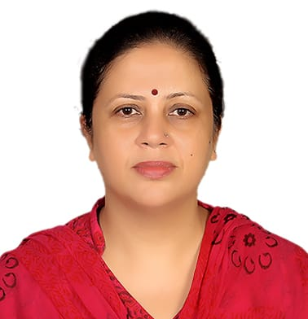
DEVIKA KANWAR
COUNCIL MEMBER, CHANDIGARH PSYCHOLOGICAL WELLBEING COUNCIL WICCI
Devika Kanwar is an enthusiastic and innovative Counseling Psychologist who has worked with many environment like schools, organization and Corporate houses. She specialises in Relationship counseling, pre- marital issues and adjustment issues.
She has worked as School Counselor as well and is comfortable in dealing with adolescent issues. She is presently working freelance with some schools, organizations etc and has a lot of experience in both online and offline counseling methods. She is well travelled hence has a good understanding of various cultures and people to aid her Counseling practice.
She has certifications in NLP, Career counseling, Pranic healing level 1, TAT technique of assessment, CBT for adolescent depression.
She has also done PG diploma in guidance and counseling from ICTRC, New Delhi. She is also associated with online counseling platforms like Manochikitsa, Fitcy, TYHO etc. She lives by the motto " I am here for you."

Slide 22
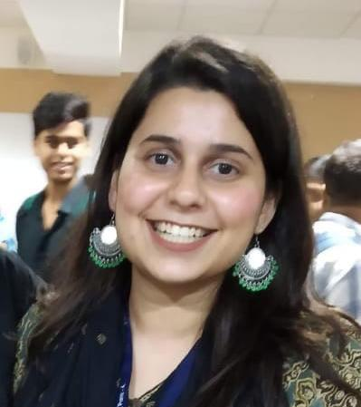
SHAMBHAVI KUMARIA
COUNCIL MEMBER, CHANDIGARH PSYCHOLOGICAL WELLBEING COUNCIL WICCI
Shambhavi is a counselling psychologist, currently working as an Assistant Professor at Rayat-Bahra University.
She works with clients suffering from anxiety, grief, assertiveness issues and de-addiction. She is empathetic and queer-friendly. She works with short-term symptomatic relief from a trauma-informed lens. She has experience of working at a de-addiction facility and training interns. She takes to social media to disseminate information and market for her mental health services over an online platform called 'All Things Mental Health Counselling Services'.
As a professional she is conscientious and kind. Her therapeutic orientations are CBT and REBT used in a client-centred framework.
Pronouns: she/they

Slide 23
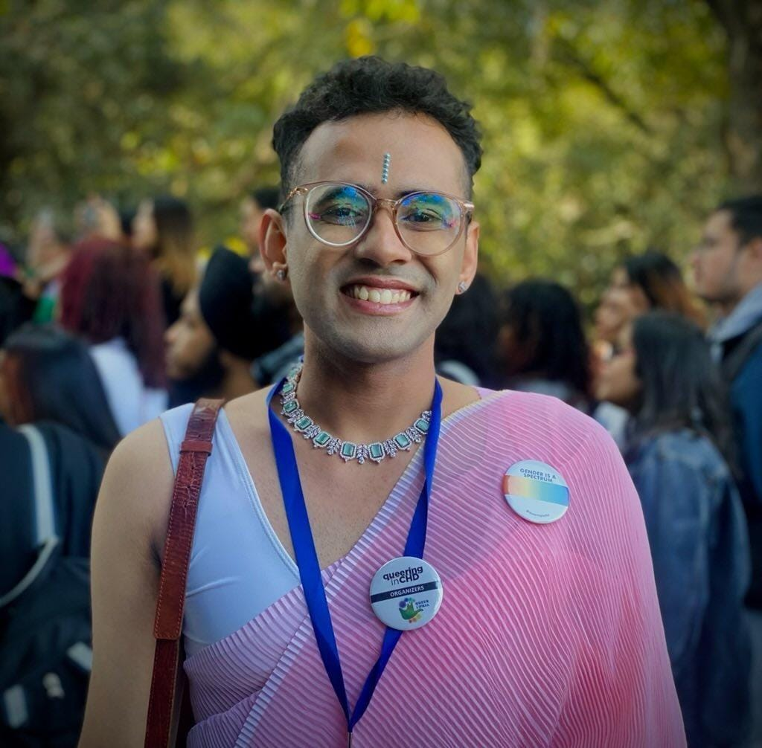
GIGI
COUNCIL MEMBER, CHANDIGARH PSYCHOLOGICAL WELLBEING COUNCIL WICCI
Gigi is a social worker and event organiser. She is working to make the world around her better. Gigi believes that if all of us put in one percent of effort to help anyone, that's gonna change the world a hundred percent.

Slide 24
ARSHITA MANRAI
COUNCIL MEMBER, CHANDIGARH PSYCHOLOGICAL WELLBEING COUNCIL WICCI
Arshita is a counselling psychologist with experience of working with neurodivergent children and as a crisis counselor. She is keen on destigmatising mental health in the society and believes that everyone deserves to be made aware of mental health & illness just like physical health.

Slide 25
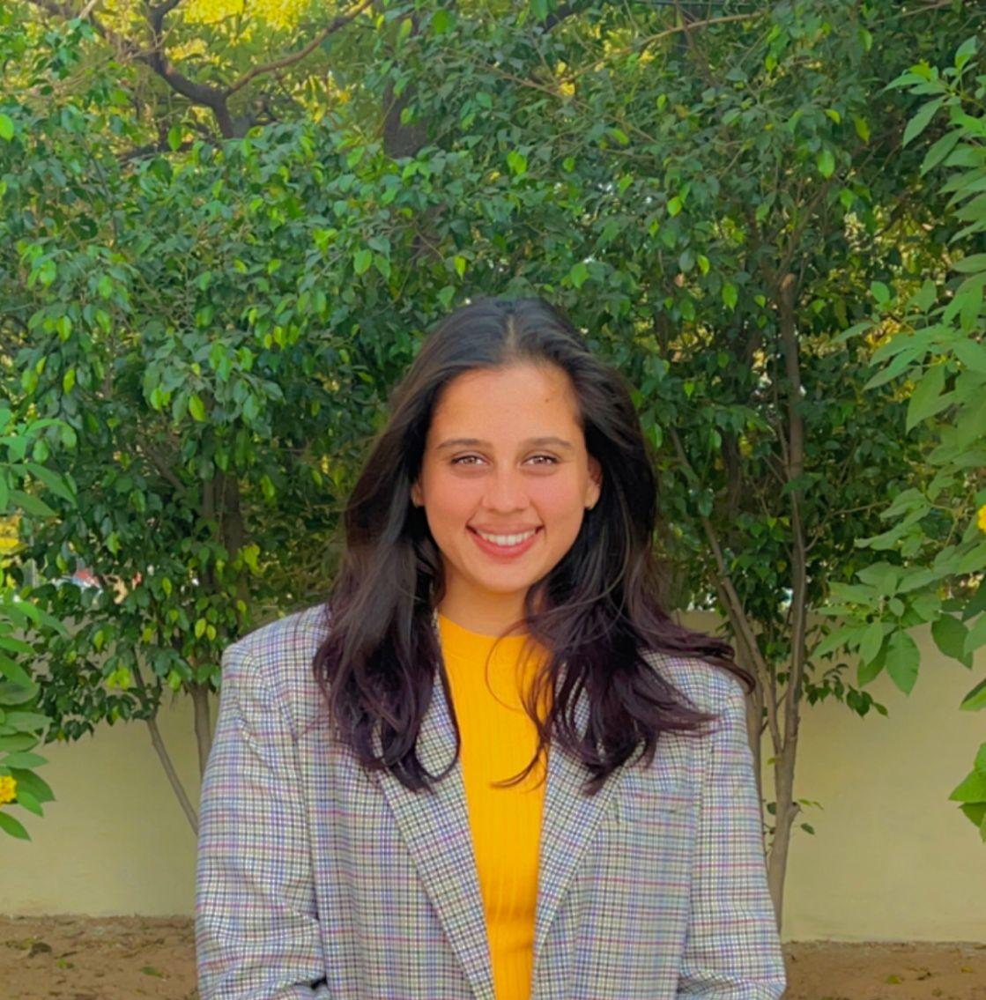
KAVYA GUPTA
COUNCIL MEMBER, CHANDIGARH PSYCHOLOGICAL WELLBEING COUNCIL WICCI
Kavya is a self-motivated, enthusiastic and reliable Counselling Psychologist with strong communication skills and passion for Mental Health Wellbeing.
She has practiced numerous therapeutic modalities, specially trained in Emotional Freedom Technique.
She has attended more than 100 patients within a span of 3 months, in the Department of Psychiatry at GMSH -16, Chandigarh. It involved taking in-depth histories, providing supportive talk therapy, performing DASS in addition to Emotional Freedom Technique. Working here was also instrumental in learning about Energy Psychology especially Acupuncture.
Kavya is looking forward to grow and enhance her current skills set and knowledge, while gaining experience and learning new ones as she moves on.

Slide 26
SUPPORTED BY
WICCI is supported by the massive global networks of ALL Ladies League (ALL), Women Economic Forum (WEF), and SHEconomy.
ALL is a movement of ‘Sisters Beyond Borders.’
WEF is a platform for ‘Business Beyond Borders.’ SHEconomy is e-commerce for women worldwide in Goods & Services for ‘Commerce Beyond Borders’

Slide 27
COUNTRIES REPRESENTED
Albania, Angola, Armenia, Argentina, Australia, Azerbaijan, Bangladesh, Brazil, Burundi, Cameroon, Canada, Chad, China, Costa Rica, Croatia, Cyprus, Czech Republic, Colombia, Ecuador, Egypt, Ghana, Germany, Greece, Guatemala, Hong Kong, Hungary, India, Italy, Israel, Ireland, Japan, Kazakhstan, Kenya, Kyrgyzstan, Lesotho, Luxembourg, Malawi, Malaysia, Mexico, Moldova, Monaco, Montenegro, Morocco, Mozambique, Malta, Netherlands, Nigeria, Nepal, New Zealand, North Macedonia, Norway, Paraguay, Portugal, Peru, Puerto Rico, Philippines, Qatar, Romania, Russia, Rwanda, Serbia, Singapore, Slovenia, Spain, South Africa, South Korea, Suriname, Sweden, Switzerland, Syria, Tunisia, Turkey, Uganda, Ukraine, UK, Uruguay, Venezuela, Vietnam, Virgin Islands (US), UAE, USA, Uzbekistan, Zimbabwe.

Slide 28
WOMEN'S INDIAN CHAMBER OF COMMERCE ANDINDUSTRY

